Slide 1
Poster title here (60-115 font)
Author list here (* on corresponding author, superscripts for affiliations) (40-48 point font)
Affiliations (20-24 point font)
Contact info for corresponding author (20-24 point font)
YOUR PHOTO
Your lab name here

Slide 2
Poster title here (60-115 point font)
Author list here (* on corresponding author) (40-48 point font)
Affiliations (20-24 point font)
Contact info for corresponding author (20-24 point font)
YOUR PHOTO

Slide 3
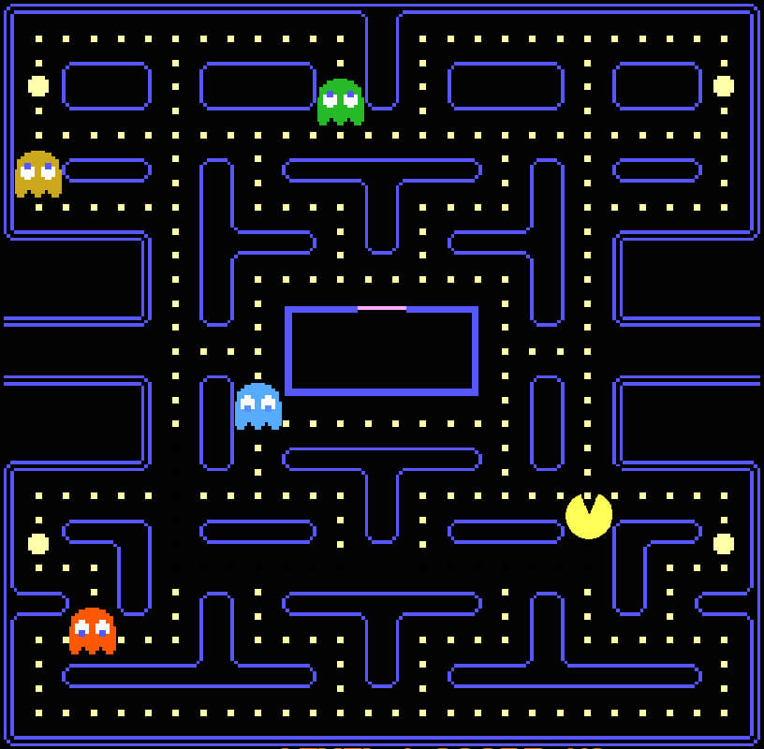
Reinforcement learning improves survival time and game performance in Pac-Man
John Smith¹, Jane Doe², Percy Gamer³, and Dr. Game Master^{*,1}
¹Dept. of Computer Science, Indiana University, Bloomington, IN USA ²Dept. of Game History, Nifty University, Metropolis, NY USA ³Dept. Non-Evil Machine Learning, Bruce Wayne City College, Gotham City, NY USA
*corresponding author: game.master@historical-gaming.indiana.edu
123
2-D video games are ideal for reinforcement learning:
  Entire screen is the current game state
  Small set of actions (simple gameplay)
  Clear objectives
  Intuitive and familiar to researchers and students.
We use Pac-Man [1] to demonstrate reinforcement learning techniques that navigate complex worlds.
Pac-Man lives in a virtual 2-D maze:
  Ghosts: Seek to eat Pac-Man
  Pac-Dots: small dots consumed
  by Pac-Man
  Power Pellets: Temporarily allow
  Pac-Man to eat ghosts
  Portals: Teleport Pac-Man
  across the maze
Pac-Man must clear all Pac-Dots
and Power Pellets without being eaten to clear the maze
Strategy drastically affects Pac-Man's survival time [2]
Reinforcement learning [3] can find optimal strategies in video games and other scenarios
  Represent current state as a vector with discrete values in a finite state-space
    Each possible state is a row in a Q matrix for Q-learning [3]
  Finitely many possible actions
    Each possible action is a column in the Q-matrix [3]
  For a given state, choose action that maximizes reward:
    Current state is a row in the Q matrix
    Column with max matrix value = choice of next state
  𝛆-greedy training: at each step choose next state:
    With 𝛆 probability:
      randomly choose new action, compute reward and update Q matrix.
      Otherwise, use max Q to choose next action, compute reward, update Q
    Repeat until Q matrix has little change. Reset game as needed.
Levels used
  5 identical ghosts ("Blinky")
  Maze geometry held constant (with discrete positions)
    Standard Pac-Man maze geometry
  No portals
  Constant level speed:
    8 movements per second
    Fastest possible maze clearance is ~30 seconds
    (RL played game 1000x faster during training)
  End game if computer hits maze or ghost
Survival time metric
  Number of seconds from start of game until Pac-Man is eaten by a ghost
  If maze is cleared, level is reset, timer continues
Human players (control group)
  Recruited 10 skilled video gamers
  Each player trained 1 hour daily (Monday-Friday) for 10 weeks
  Average survival time (3 replicates/player) measured every Friday
Reinforcement Learning (RL)
  Used 𝛆-greedy Q learning [3]
  State vector:
    ASCII sequences for current and prior time:
      P: Pac-Man
      s: empty space
      m: maze (obstacle)
      d: Pac-Dot
      e: Power Pellet
      G: ghost
    Simplification: just record state in 5x5 grid:
      Pac-Man's location and immediately adjacent screen locations
  Actions:
    Move left, right, up, down.
    Motion into portals or maze disallowed
  Rewards and Penalties based on Pac-Man's location:
    -g for touching Ghost (w/o Power Pellet)
    +e for touching Ghost (with Power Pellet)
    +s for empty space
    +d for Pac-Dot
    +p for Power Pellet
    Capital letters:
      accumulated points for each category before death.
  Virtual game implemented in NeatoSimPacManLib Version 3.7 [4]
Evaluation
  At 10 weeks, human players (n = 10, 3 runs per player) and RL strategy (30 runs) were tested for survival time
  Used Student T-test (2-tail, unequal variances) to evaluate if means were significantly different, with p=0.05 used accept the the survival times as significantly different
Human Training
RL Training
  Total reward: R = -G+E+S+D+P
  Reward function:
    Maximize survival time
    1 unit of survival for each "clock tick" that isn't a ghost
      s = d = p = e = 1
    Extreme penalty for ghost
      g = 100,000,000
  Training:
    Random initial Q matrix
    Poor performance for first 50,000 games
    Consistently cleared 1 level by 360,000 games
    Consistently cleared 3 levels by 600,000 games
    Converged by 1,500,000 games
      No entries in Q matrix changed more than 1%
    Score presented below (prior to death penalty):
Comparison of Human and RL
  Human players (30 trials):
    Mean survival time: 142.4 sec
    Standard deviation: 59.3 sec
  Reinforcement learning (30 games):
    Mean survival time: 166.5 sec
    Standard deviation: 16.6 sec
  Student T-test
    p = 0.034 that human and RL players have same mean survival time.
Human players improved throughout training, but with decreasing returns.
RL steadily improved through each virtual game
RL strategy beat skilled human players
Work neglected:
  Real Pac-Man has 4 ghosts with different strategies
  Mazes can change in complexity
  Game speed increases after each level
Gained experience in reinforcement learning
Future work:
  Mixed objectives: complete level faster, maximize score
  Add different ghost types
  Increase "vision" to 7x7 "grid" of points
  Try deep reinforcement learning:
    Nonlinear Q(state,action) with deep neural network
Ghost
Power Pellet
Pac-Dots
Pac-Man
Classic Pac-Man level
[1] T. Iwatani. "Pac-Man", Namco 1980.
[2] A.M. Gamer et al. Review of Pac-Man. J. Gaming and Neat Stuff 42(1):1-10, 1984.
[3] A. Scientist. Reinforcement Learning Techniques: Review and Best Practices. J. Perfect Machine Learning Methods 42(1):1-38, 2050.
[4] A. Coder. NeatoSimPacManLib for Virtual Game Environments focused specifically around PacMan, by some amazing coincidence. Version 3.7. https://github.com/acoder/NeatoSimPacManLib.
We aim to find better game play strategies that increase Pac-Man's survival time compared to typical skilled players.
This work was funded by the American Society for Pac-Man Domination and the NSF (929493984)
IU Bloomington contributed 1,000 CPU-hours on BigRed 200 for this work.
We thank the Indiana Pac-Man Association for useful discussions and espresso.
GameMaster Lab

